Slide 1
KEYLOGGER AND SECURITY
CYBER SECURITY
Presented By:
Mohammed Shaahidh A
IT Department
Kings engineering college

Slide 2
OUTLINE
Problem Statement
Proposed System/Solution
System Development Approach
Algorithm & Deployment
Result (Output Image)
Conclusion
Future Scope
References

Slide 3
Problem Statement
Develop a secure keylogger application named "Keylogger and Security" that records user keystrokes and provides features to manage the keylogging process effectively. The keylogger should be capable of running in the background, capturing keystrokes, and storing them securely. Additionally, the application should offer functionalities to start and stop the keylogging process as per the user's requirement. Furthermore, ensure that the captured keystrokes are stored in both text and JSON formats for easy analysis and retrieval. Implement proper error handling and user interface elements for a seamless user experience. The primary objective is to create a reliable and user-friendly keylogging tool with robust security measures to prevent unauthorized access to the recorded keystrokes.

Slide 4
Proposed Solution
Background Keylogging: The application will run discreetly in the background, capturing all user keystrokes without interrupting the user's activities.
Keystroke Capture: Utilizing the pynput library, the application will monitor keyboard input and record each keystroke along with its corresponding event (pressed, held, or released).
Data Storage: The captured keystrokes will be stored securely in two formats:
Text Format: Keystrokes will be saved in a text file ('key_log.txt') for easy access and readability.
JSON Format: Keystrokes will also be stored in a JSON file ('key_log.json') for structured data storage and analysis.
Start/Stop Functionality: The application will provide user-friendly buttons to start and stop the keylogging process. This feature ensures that users have control over when the keylogger is active.
Error Handling: Robust error handling mechanisms will be implemented to handle exceptions gracefully and ensure the stability of the application under various scenarios.
User Interface: The application will feature a simple and intuitive graphical user interface (GUI) built using the Tkinter library. The GUI will display status messages, such as whether the keylogger is running or stopped, providing clear feedback to the user.
Security Measures: To maintain user privacy and prevent unauthorized access to the recorded keystrokes, the application will incorporate security measures such as:
File Encryption: Optionally, the application can encrypt the text and JSON files containing keystroke data using cryptographic algorithms to protect sensitive information.
Access Control: Implement authentication mechanisms to restrict access to the keylogger settings and logs, ensuring that only authorized users can start, stop, or view the captured keystrokes.
Documentation and Support: Comprehensive documentation will be provided to guide users on how to use the application effectively and securely. Additionally, user support channels will be established to address any queries or issues encountered during usage

Slide 5
System Approach
Python was chosen for its simplicity and rich library support. The 'pynput' library facilitated keylogging functionality. Tkinter, a lightweight and built-in Python library, was employed for GUI development, ensuring user-friendly interfaces. Threading was utilized to maintain GUI responsiveness during logging.
Compatible with both Linux and Windows platforms, the application leverages the tkinter library for GUI consistency and ease of development.

Slide 6
Algorithm & Deployment
Initialization:
Initialize essential variables and prepare output files ('key_log.txt' and 'key_log.json') for keystroke logging.
User Interface Activation:
Utilize Tkinter to create a user-friendly GUI with controls for starting and stopping the keylogger. Display status messages to keep users informed about the keylogger's operation.
Listener Setup:
Set up a key press listener using the 'pynput' library. This listener runs asynchronously to capture keyboard events while maintaining GUI responsiveness.
Event Handling:
Implement callback functions ('on_press' and 'on_release') triggered by the key press listener. These functions handle key press and release events, updating flags and output files accordingly.
Data Logging:
Log keystrokes in real-time to both text and JSON files. The text file maintains sequential keystroke records, while the JSON file structures each event with type and associated key.
Process Loop:
Continuously log keystroke information until the user initiates the stop command via the GUI. Upon receiving the stop command, gracefully terminate the keylogger.
Safe Termination:
Upon receiving the stop command, set a flag to halt the key press listener, ensuring a smooth end to the keylogging session. Update the GUI to notify users of the cessation of logging.
File Closure:
Ensure proper closure of all output file streams post-logging to uphold data integrity.

Slide 7
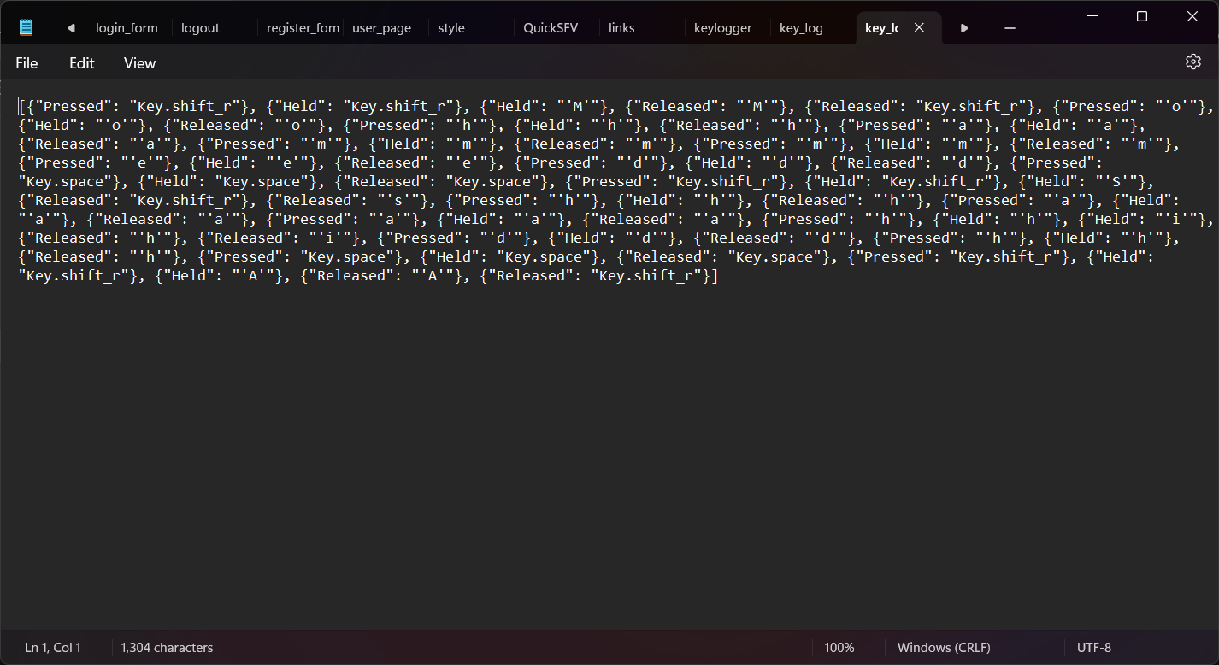
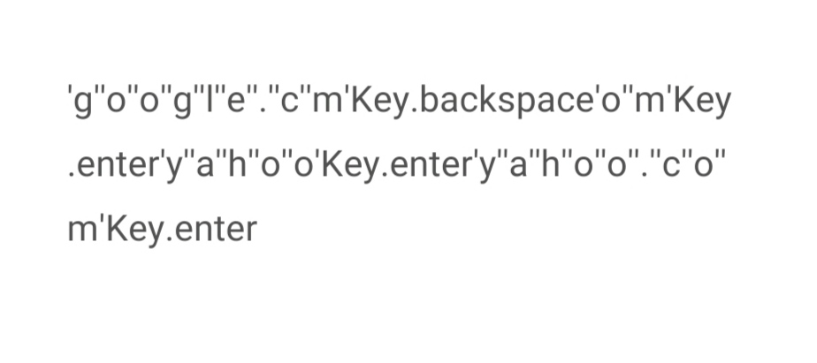
Result

Slide 8
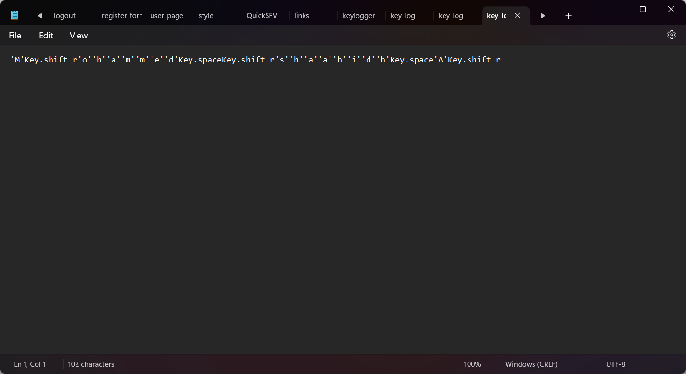
Result

Slide 9
Conclusion
The development of the "Keylogger and Security" application has resulted in a robust tool for capturing keystrokes while prioritizing user privacy and data security. The application effectively logs keystrokes in real-time, stores them in both text and JSON formats, and provides a user-friendly interface for controlling the keylogging process. With proper security measures in place, the application ensures the integrity and confidentiality of the captured information.

Slide 10
Future scope
The future scope of this keylogger project is promising. Potential enhancements include strengthening security measures with advanced encryption techniques, integrating machine learning algorithms for more sophisticated pattern detection, implementing customizable filters to track specific types of key events effectively, and enabling cloud integration for remote access and secure storage of logged data. Additionally, expanding compatibility to include mobile platforms could greatly enhance the tool's versatility and usefulness. As technological advancements continue, ensuring the adaptability and ethical use of such systems will remain essential.

Slide 11
References
As an AI language model, I generate responses based on a mixture of licensed data, data created by human trainers, and publicly available data. I have not been trained on specific databases of references or citations. If you need references for your project, I recommend consulting authoritative sources in the field of cybersecurity, software development, and data privacy. Additionally, you may refer to documentation and resources for the libraries and tools used in your keylogger project, such as the pynput library and the Tkinter GUI toolkit.

Slide 12
THANK YOU

